Slide 1
Content Delivery Networks (CDN) in System Design
Networking & Communication

Slide 2
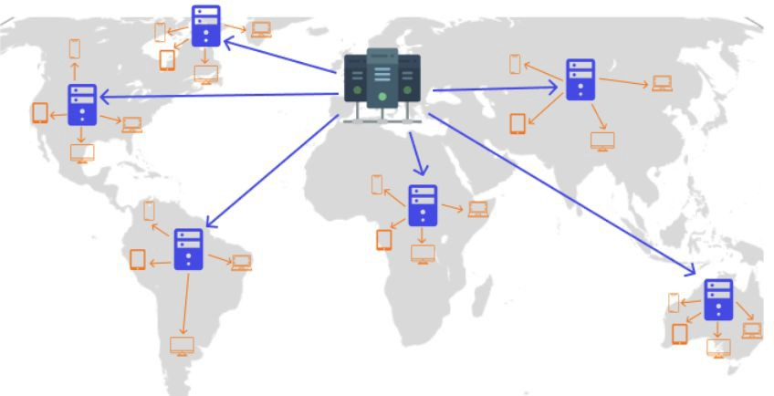
Introduction to CDNs
Deﬁnition: A CDN is a globally distributed network of servers that work together to deliver content eﬃciently.
Why CDNs exist:
  Reduces latency
  Enhances content availability
  Improves load handling
  Security

Slide 3
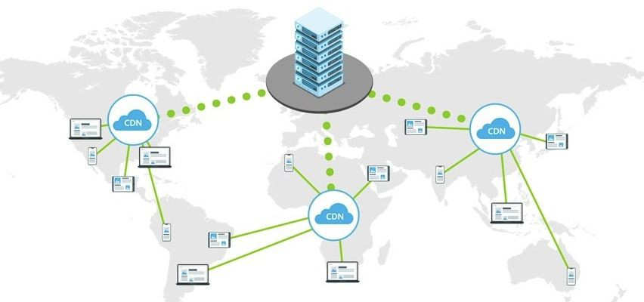
Why are CDNs needed?
The problem without CDNs:
High latency due to geographic distance
Overloaded origin servers
Bandwidth constraints & slow load times

Slide 4
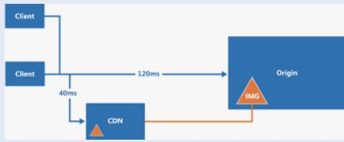
CDN Architecture Overview
Components of a CDN:
  Origin servers: Store the original content
  Edge servers (PoPs): Store cached content closer to users
  Request routing system: Directs users to the nearest PoP

Slide 5
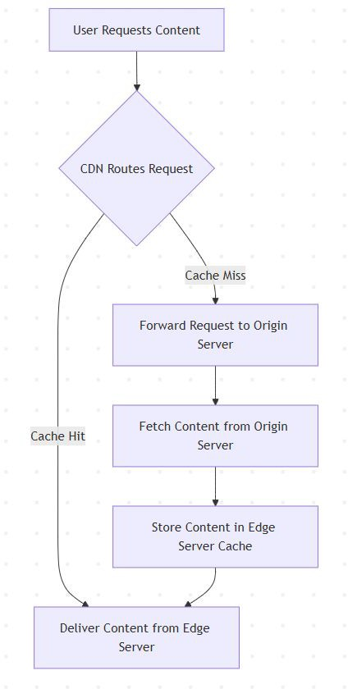
How a CDN Works and Handles a User Request
User requests content (e.g., website, video, API data).
CDN directs the request to the nearest edge server based on geographic location, network latency, and server load.
Cache Hit: If the content is available on the edge server, it is delivered instantly.
Cache Miss: If the content is not cached, the request is forwarded to the origin server, fetched, and stored at the edge server for future use.

Slide 6
Key CDN Features/Beneﬁts of CDN Working Mechanism
Caching & Replication(Reduced Latency): Frequently accessed content is stored at edge locations to minimize origin server load.
Load Balancing and request routing:(Improved Availability) Traﬃc is distributed across multiple PoPs to ensure reliability and prevent overload. CDN uses Geo-based, latency-based, and load-aware routing to optimize speed.
Compression & Optimization(Lower Bandwidth Costs): Techniques like Gzip, Brotli, and image optimization reduce ﬁle sizes for faster delivery.
Security Features(Better Security): DDoS Protection, SSL/TLS

Slide 7
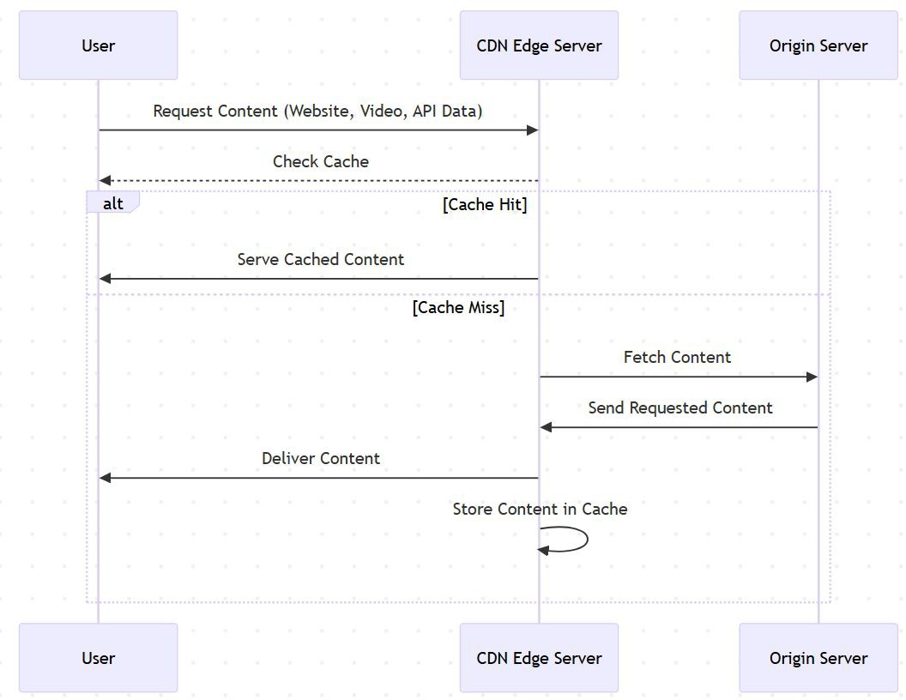
Content Caching and Replication
How CDNs cache content:
  Frequently accessed content is stored at the edge servers
  Cache expiration and TTL (Time-To-Live) settings control freshness
  Cache invalidation strategies (manual purge, stale-while-revalidate)

Slide 8
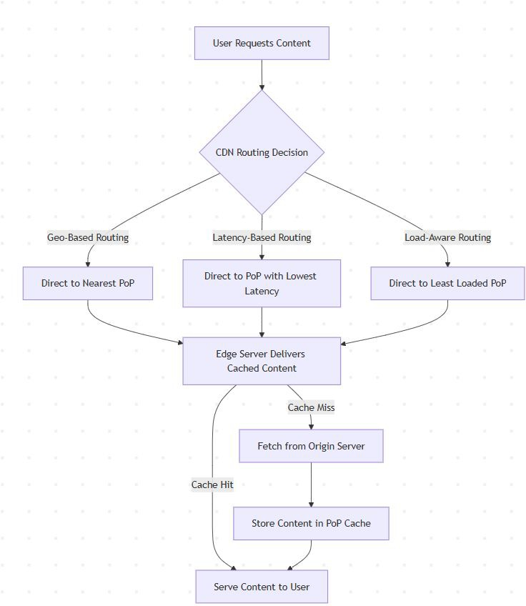
Load Balancing/Failover Handling and Request Routing
Load balancing across multiple PoPs
Failover strategies:
  Rerouting to another PoP
  Dynamic origin selection
Request routing strategies:
  Geo-based routing: Directs users to the nearest PoP
  Latency-based routing: Chooses the PoP with the lowest latency
  Load-aware routing: Balances traﬃc across PoPs

Slide 9
Compression & Miniﬁcation
Techniques used:
  Gzip & Brotli compression
  Image optimization (WebP, AVIF)
  Minifying CSS/JS to reduce ﬁle sizes

Slide 10
Security Features
DDoS mitigation:
  Rate limiting
  Traﬃc ﬁltering
SSL/TLS Oﬄoading: Encrypts traﬃc for security

Slide 11
Use Cases of CDNs
Static vs. Dynamic Content Delivery
  Static content: Images, videos, HTML ﬁles.
  Dynamic content: API responses, personalized pages.
API Acceleration & Edge Computing(CDNs for APIs):
  Reduce API response times.
  Edge caching for frequently accessed endpoints

Slide 12
Basics of CDN
  What is a CDN, and how does it work?
  Why do we need CDNs in system design?
  What are the key beneﬁts of using a CDN?
CDN Architecture & Components
  Explain the diﬀerence between an origin server and an edge server in a CDN.
  What is a PoP (Point of Presence) in a CDN?
  How does request routing work in a CDN?
Caching Strategies & Content Delivery
  What is a cache hit vs. cache miss, and how does a CDN handle them?
  Explain cache expiration and TTL (Time-To-Live) in a CDN.
  What are cache invalidation strategies, and why are they important?
  How does a CDN handle dynamic content caching?
Load Balancing & Failover Handling
  How do CDNs use load balancing to improve reliability?
  Explain diﬀerent request routing strategies (Geo-based, Latency-based, Load-aware).
  What happens if a CDN PoP fails? How does failover handling work?
CDN Optimization Techniques
  What compression and miniﬁcation techniques do CDNs use?
  How does a CDN optimize image and video delivery?
  How does API acceleration work in a CDN?
CDN Security & Challenges
  How does a CDN protect against DDoS attacks?
  What is SSL/TLS oﬄoading, and why is it useful?
  What are some challenges in CDN implementation, and how can they be mitigated?
Advanced CDN Topics
  How does a multi-CDN architecture work?
  What is edge computing, and how does it relate to CDNs?
  How would you design a CDN for a large-scale video streaming platform?
  How do CDNs help in real-time applications like online gaming or stock trading?

Slide 13
Wrap-Up & Key Takeaways
CDNs improve performance by caching and distributing content globally.
They reduce latency, improve load times, and lower bandwidth costs.
CDNs enhance security with DDoS protection, SSL/TLS encryption, and WAFs.
Use cases include static content delivery, API acceleration, and edge computing.
Next Topic:
  Networking Fundamentals Summary & Best Practices

Slide 14
Summary of Covered Topics - Networking & Communication
Introduction to Networking in System Design – Why networking is crucial in distributed systems.
Understanding IP Addresses – Diﬀerences between IPv4 & IPv6, public vs. private IPs.
How DNS Works – Domain Name Resolution, caching, and its role in large-scale systems.
Client-Server Model Explained – How clients and servers interact using request-response cycles.
Forward Proxy vs. Reverse Proxy – Their diﬀerences, use cases, and impact on system design.
Introduction to Load Balancing – Why it's needed, types of load balancers, and balancing strategies.
What is an API Gateway? – Managing API traﬃc, enforcing security, and enabling eﬃcient routing.
Content Delivery Networks (CDN) in System Design – How CDNs improve performance and reduce latency.
Whats Next
  Protocols

